Slide 1
Sports Drink Market Analysis
SCM651
SIYAO XU
YIFAN LIU
PAN CHEN

Slide 2
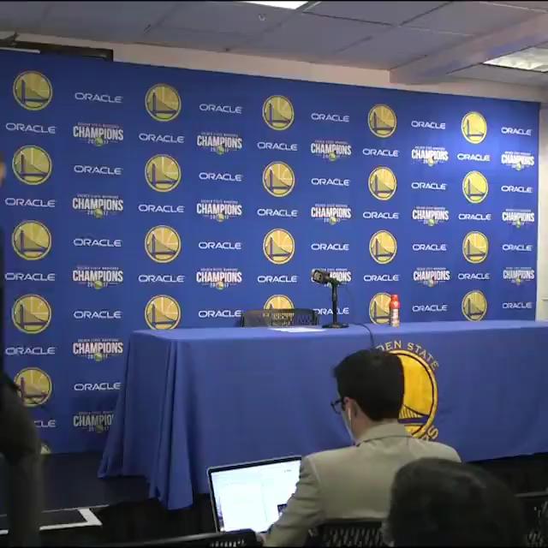
What is Sports Drink???

Slide 3
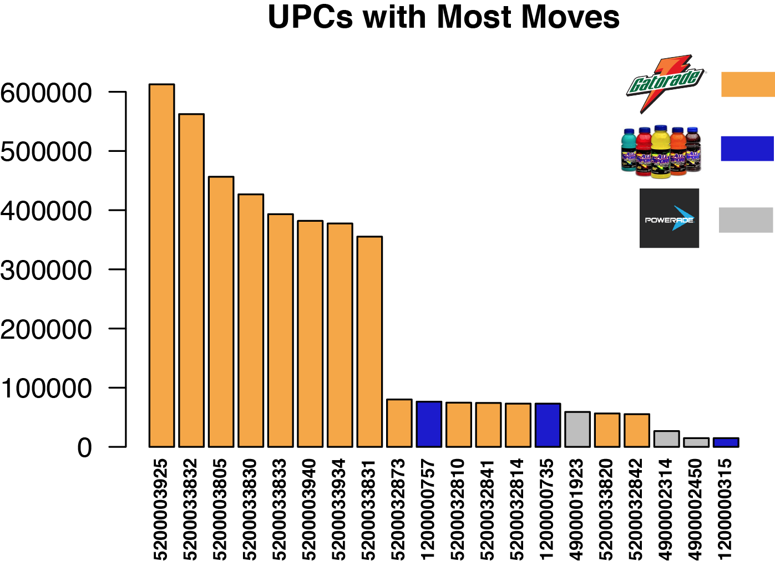
Data Selection
Notes:
Our objective for the presentation is to use all we’ve learned from this class to find the possible factors that affect the sales of sports drink in Domick’s grocery chains.
We have selected

Slide 4
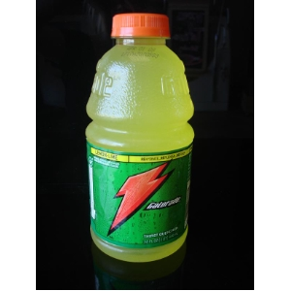
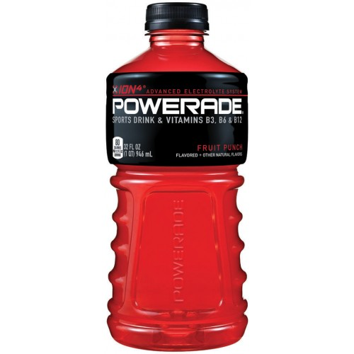
Best Seller of each Brand
UPC | Brand | Variety | Brand Type
5200003925 | GATORADE | LEMON/LIME 32OZ 12 | National
4900001923 | POWERADE | FRUIT PUNCH 32OZ 12 | National
1200000757 | ALL SPORT | FRUIT PUNC 32OZ 12 | Less-known

Slide 5
Research Questions
How does the price vary across brands?
What factors affect demand of national brands and store brands?
What factors affect demand of the two national brands?
What is the price elasticity of demand of a brand?
Is price elasticity different for different brands?
How does the probability that the product is on sale depend on brand?

Slide 6
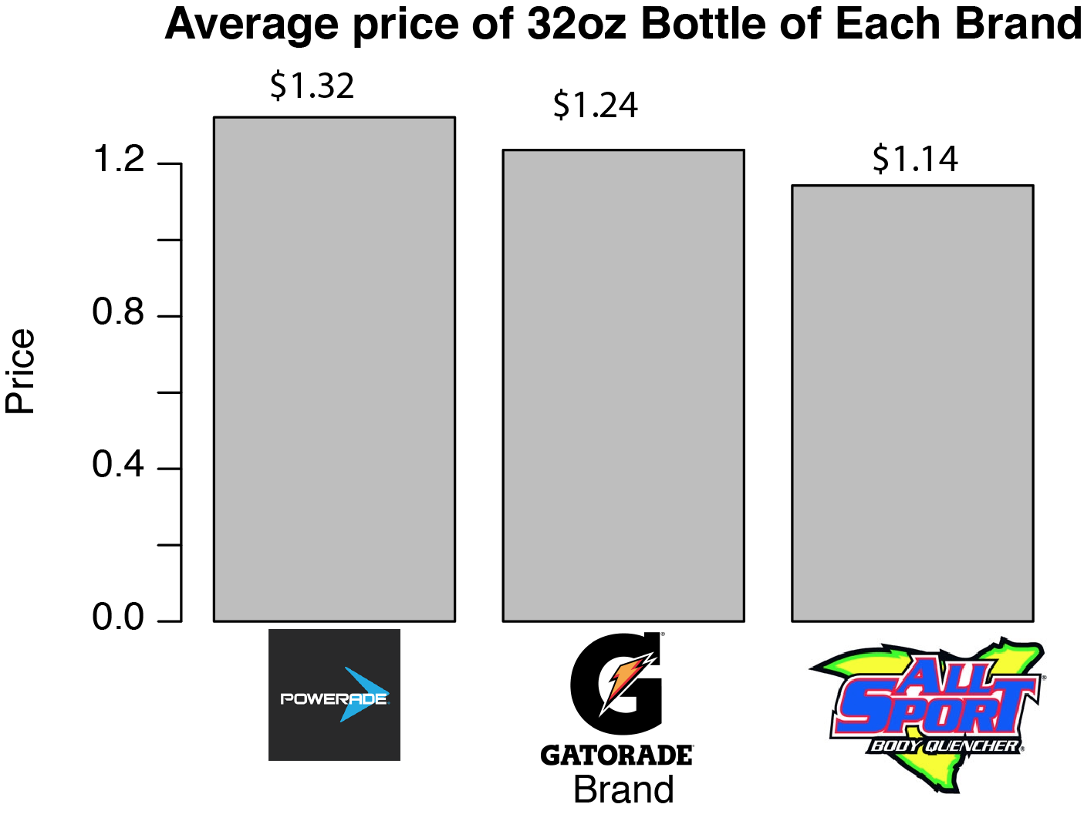
How does the price vary across brands?

Slide 7
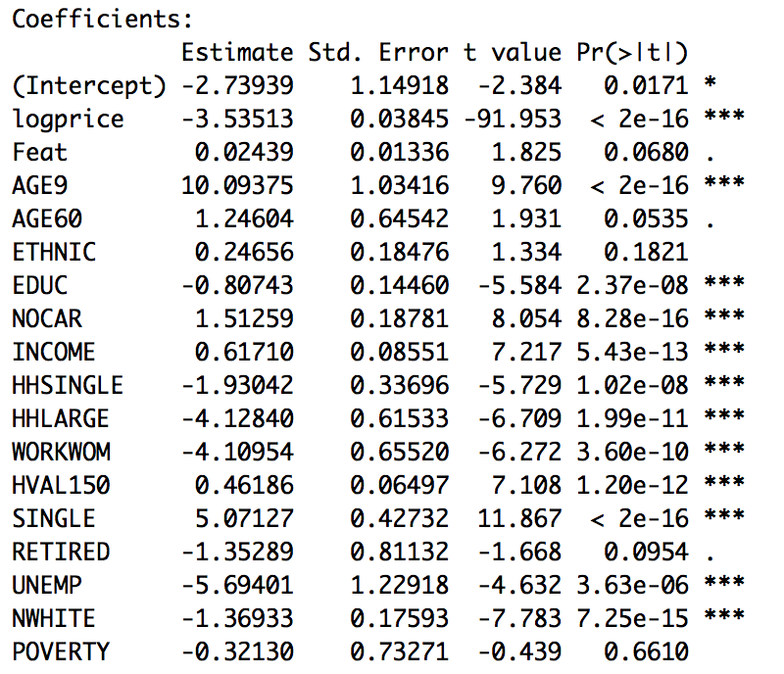
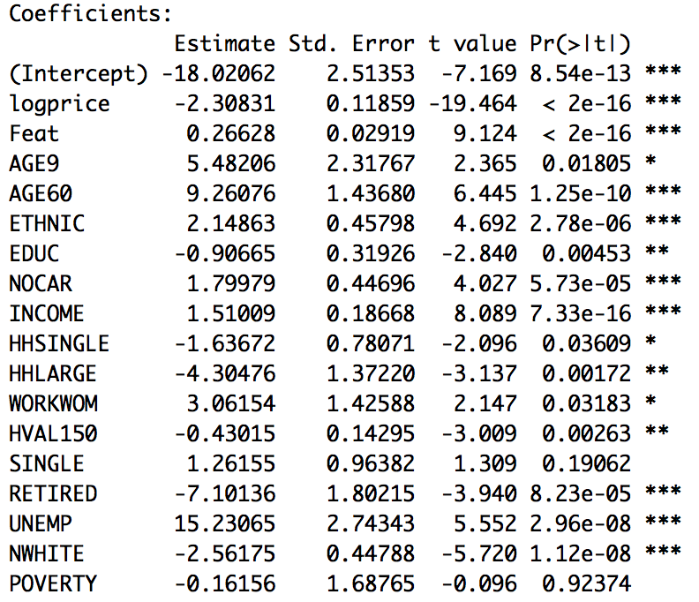
2. What factors affect demand of national brands and store brands?
National Brand
Store Brand
Notes:
It looks like percentage with more 60 plus people, more people of minorities and more unemployed national brands are great indicators of the sales of Store brands than the national brands, while areas with more 9 minus population and single population are great indicators of the sales of national brands….
And the effect of being on sale in stronger for store brands than national brands

Slide 8
NEXT
To further analyze the data, we broke down the national brands dataset into two subsets based on brand: Gatorade and Powerade.

Slide 9
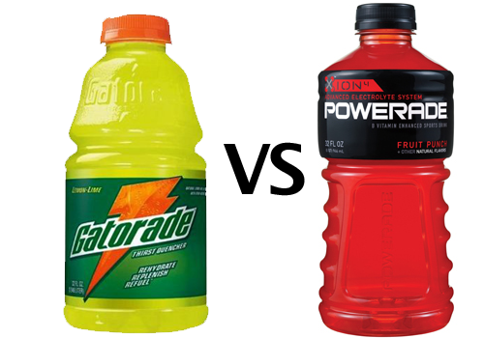
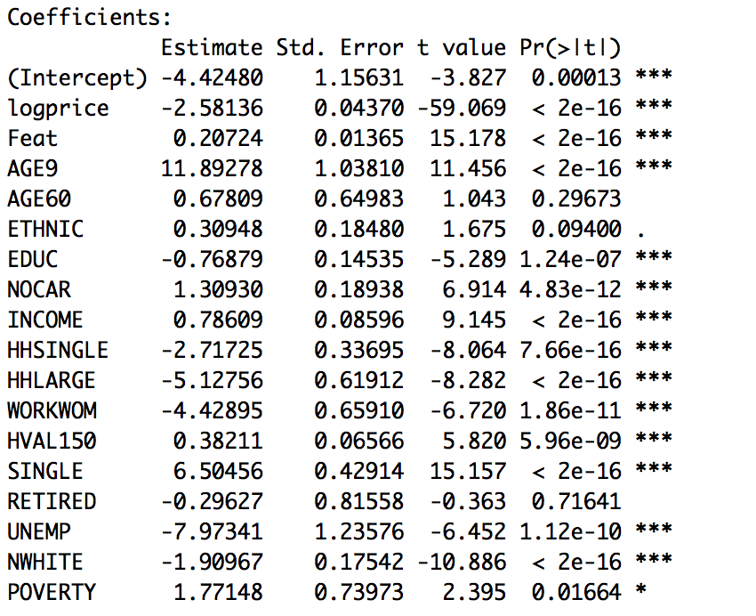
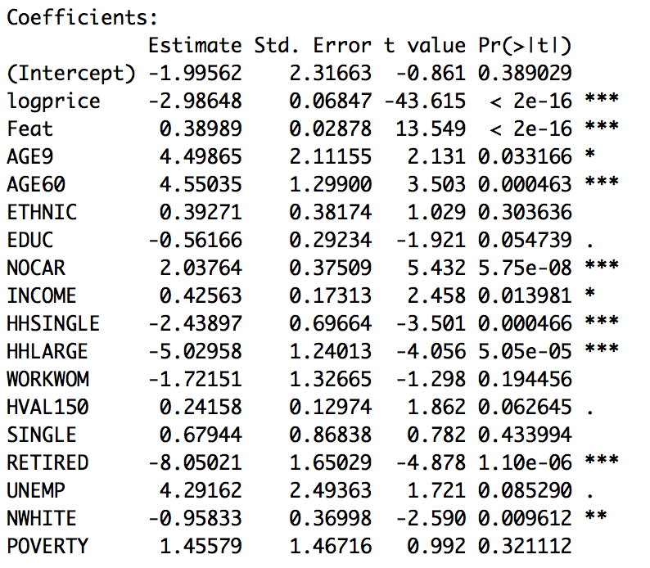
3. What factors affect demand of the two national brands?
Gatorade
Powerade
Notes:
IT looks like the effect of being on sale is stronger for powerade than gatorade, and an area with more single people is a great indicator of better sales of gatorade,

Slide 10
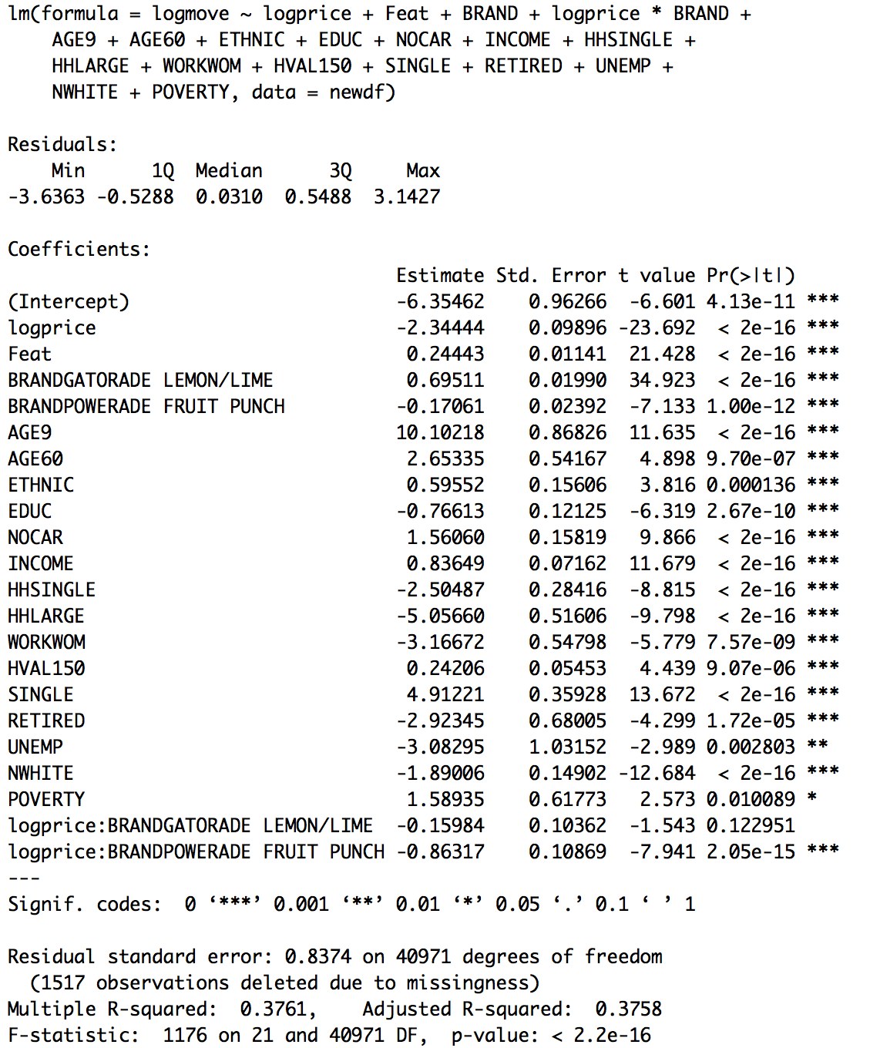
4. What is the price elasticity of demand of a brand?
5. Is price elasticity different for different brands?
Gatorade Lemon/Lime: Price Elastcity of Demand=2.50428
Powerade Fruit Punch: Price Elastcity of Demand=3.20761
All Sport Fruit Punch : Price Elastcity of Demand=2.34444

Slide 11
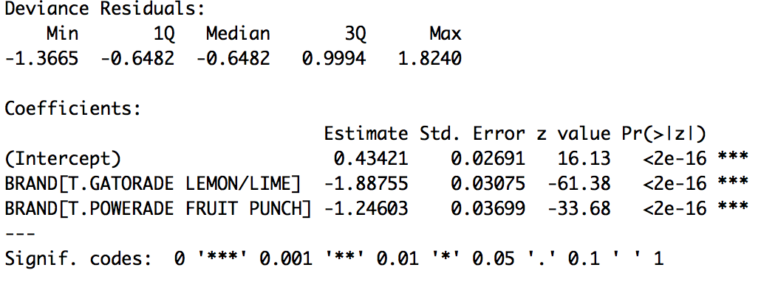
6. How the probability that the product is on sale depends on Brand?
Logit Model

Slide 12
Conclusions
To compete with national brands, store brands like Allsport could be promoted more in the areas with more senior people, minorities and unemployed people
To compete with Gatorade, Powerade could be put on sale more frequently
Since Powerade has the highest price elasticity of demand of all three brands, price reduction is likely to increase sales volume.

Slide 13
Q&A
Thank You!

